Slide 1
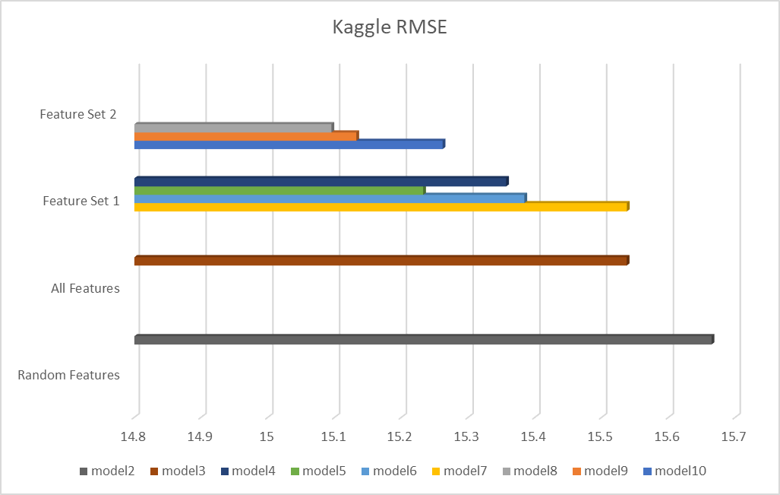
Predictive Analysis Competition Project
FEATURE SELECTION
ID, Performer, & Song not included.
Feature Set 1 = Best Subset Selection
Dummy values (1 or 0) for Top 10 Genres
Feature Set 2 = Best Subset Selection + Genre Dummy Values
Key & Mode Dropped
Jason Costa
TYPES OF MODELS
Linear Regression = Model 2, 3, 4, & 8
GAM = Model 5
Bagged Random Forest = Model 6 & 10
Boost = Model 7 & 9
FUTURE DIRECTIONS
Run more models, specifically a tuned boost model
*BEST MODEL*
MODEL 10 - BAGGED RANDOM FOREST
FEATURE SET 2
RMSE of 15.09508

